Slide 2
Food in art
Get ready for lots of apples

Slide 3
literature

Slide 4
„Pan Tadeusz” Adam Mickiewicz
„Pan Tadeusz” is a Polish book by Adam Mickiewicz. It is aunique book because it is written in verse. There is description of feast with typical polish food in it. You can read about: Borsch, Old Polish broth-it was artificially cooked and a few pearls and a coin were added to it (in those days people believed that such broth would cleanse the blood and improve health), fish including Salmon and uncut fish, fried head, baked inside, with a casserole with sauce on the tail

Slide 5
Hesperidian orchard
In Hesperides there were 3 sisters taking care of garden of the gods in which grew a tree (or trees) bearing golden apples. The dragon Ladon helped them guard the apples. Getting the golden apples was one of Heracles' 12 works . Polish author Jan Kochanowski mentioned the Hesperid orchard and the apple tree growing in it in his limerick: „Na Lipę”

Slide 6
Legend of apple trees
In Poland we have story about 3 sisters taking care of apple tree too. They are called „Jabłonki”-in Eng. Apple trees. They lived on the bank of the river, later called the Vistula and all neighbours loved them or at least appreciate them. Sisters were organising a lot of feasts for their neighbours. Once upon a time on one of the sisters’ feasts, young smith heard them whispering to each other. He decided to sneak to a part of orchard where only sisters were allowed to go. There was the most beautiful apple tree. „Jabłonki” danced around this tree and every few moments they kissed one fruit and put it gently to chest- thanks to these apples they were always young. One sister was about to kiss the fruit before picking it when the young blacksmith stucked his mouth out. Sisters blushed and apples on the tree changed color from green to red. Smith took one of chests and started to run to a village but he fell down and passed out for a while. When he woke up he saw sisters. They gave him a chance to give back the chest to them but he didn’t listen and he tried to run away again. Then he started changing. He became an apple tree with red and sweet apples. After that „Jabłonki” weren’t everlasting anymore.

Slide 7
Paintings and sculptures

Slide 8
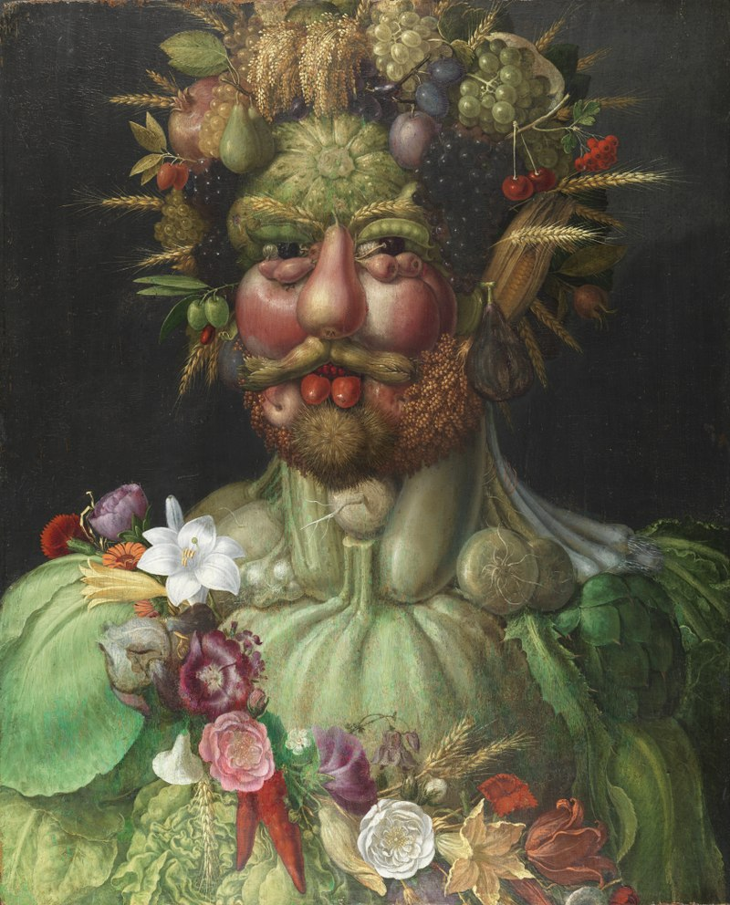
Arcimboldo and food in his art
Emperor Rudolf II of Habsburg as Vertumnus

Slide 9
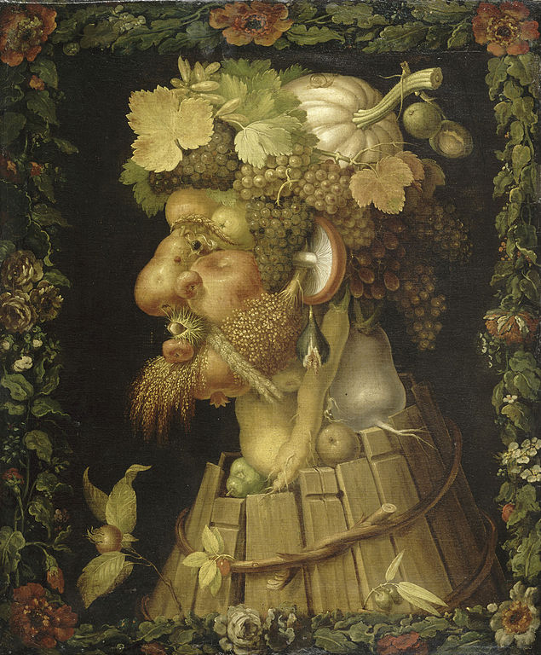
Arcimboldo and food in his art
autumn

Slide 10
Arcimboldo and food in his art
And many others

Slide 11
maidy morhous and food in her art
3 second rule

Slide 12
maidy morhous and food in her art
Don’t kill the goose!

Slide 13
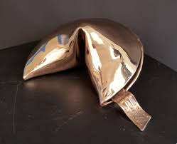
maidy morhous and food in her art
And many more!

Slide 14
Music

Slide 15
Halina Kunicka - Niech no tylko zakwitną jabłonie
Eng. Halina Kunicka –just let the apple trees bloom
Polish song.
Author: Halina Kunicka.
Refrain:
The world is not so bad
The world is not bland at all
Just let the apple trees bloom

Slide 16
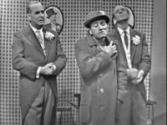
Kabaret starszych panów- Addio pomidory
Old gentelmen’s cabaret- Addio tomatoes
Polish song.
Author:Old gentelmen’s cabaret-Wiesław Michnikowski
Refrain:
Addio tomatoes
addio favorites
suns setting behind my winter table
The uneaten salad evenings are coming again
An overwhelming longing and a tear swallowed halfway down

Slide 17
Made by: kinga Rybińska in cooperation with and edited by Karolina Klech

